Slide 1
CSE-311 Project
Project Name: Event Management System
Project Group No.: 14
Project Members: 1.Md. Rakibul Islam (2131604642) 2.Fariha Akter Resha (2131934642)
Course: CSE311
Section: 09
Faculty Initial: ITN
Lab Instructor: Zia Uddin Chowdhury

Slide 2
EVENT MANAGEMENT SYSTEM
INTRODUCTION:
In the world of event planning, Our project stands as a transformative force in the realm of event management. We've created a platform that simplifies organizing all kinds of celebrations, from weddings to birthdays and everything in between. Our focus is on making things easy for administrators, giving them the tools they need to manage events effortlessly. Our system is designed to be user-friendly, with simple interfaces and helpful features
SPECIALTIES:
Modular Event Management: The system is designed with modularity in mind, accommodating different event types seamlessly. Whether it's a grand wedding, a lively birthday bash, or an electrifying music show, administrators can effortlessly manage each event category with dedicated functionalities.
User-Friendly Interface: The user interface is intuitive and user-friendly, leveraging Bootstrap for responsive design and interactive components. Administrators can navigate through user accounts, view upcoming events, and perform actions like event deletion with ease.
Dynamic Modal Dialogs: Modal dialogs are dynamically generated for confirmation prompts when deleting users or events. This enhances user experience by providing clear feedback and ensuring that critical actions are deliberate and irreversible.
Upcoming Event Display: The system intelligently displays upcoming events for each event category, enabling administrators to stay informed about scheduled events. This feature aids in planning and coordination, ensuring that events are managed effectively and executed seamlessly.
Scalable Architecture: The architecture of the system is scalable, allowing for the addition of custom event types as per the requirements of the application. The "Other Events (Other Dashboard)" category provides flexibility for users to add and manage diverse event types beyond the predefined categories.
Comprehensive Error Handling: The system incorporates comprehensive error handling mechanisms, providing informative error messages in case of database errors or unsuccessful operations. This ensures reliability and robustness, enhancing the overall stability of the system.
Secure Session Management: Session management is implemented securely to maintain user authentication state across multiple page requests. This mitigates security risks and unauthorized access, safeguarding sensitive user data and administrative functionalities.

Slide 3
TECHNOLOGIES:
PHP: PHP is used for server-side scripting to handle dynamic content generation, database interactions, and server-side processing.
MySQL Database: The project utilizes a MySQL database to store and manage user accounts, event details, and other related data.
Bootstrap: Bootstrap framework is used for front-end development to create a responsive and visually appealing user interface. It provides pre-designed CSS and JavaScript components for styling and layout purposes.
jQuery: jQuery library is included for client-side scripting to simplify DOM manipulation, event handling, and asynchronous HTTP requests. It enhances the user interface and provides interactive features.
HTML: HTML (Hypertext Markup Language) is used for structuring the content of web pages. It defines the layout and elements of the user interface, such as tables, forms, and modal dialogs.
CSS: Although not explicitly shown in the script, CSS (Cascading Style Sheets) can be used for styling and customizing the appearance of HTML elements to improve the visual presentation of the web pages.
Session Management: PHP session management is implemented to maintain user authentication state across multiple page requests. It ensures secure access control and data protection.
This comprehensive set of technologies collaborates to form the backbone of the project, facilitating efficient event management and ensuring a seamless user experience.

Slide 4
WORK DISTRIBUTION:
Fariha Akter Resha: was responsible for frontend design, which includes creating a visually appealing and user-friendly interface for the web application. She was involved utilizing technologies such as HTML, CSS, Bootstrap to design and implement the layout, styling, and interactive components of the user interface. She focused on ensuring that the frontend design met usability and accessibility standard
Md. Rakibul Islam: was assigned to backend development and database management. His responsibilities included implementing server-side functionality using PHP, handling database interactions, and ensuring the integrity and security of the MySQL database, used jQuery for event handling and DOM manipulation . He collaborated with the frontend designer to integrate frontend and backend components seamlessly.

Slide 5
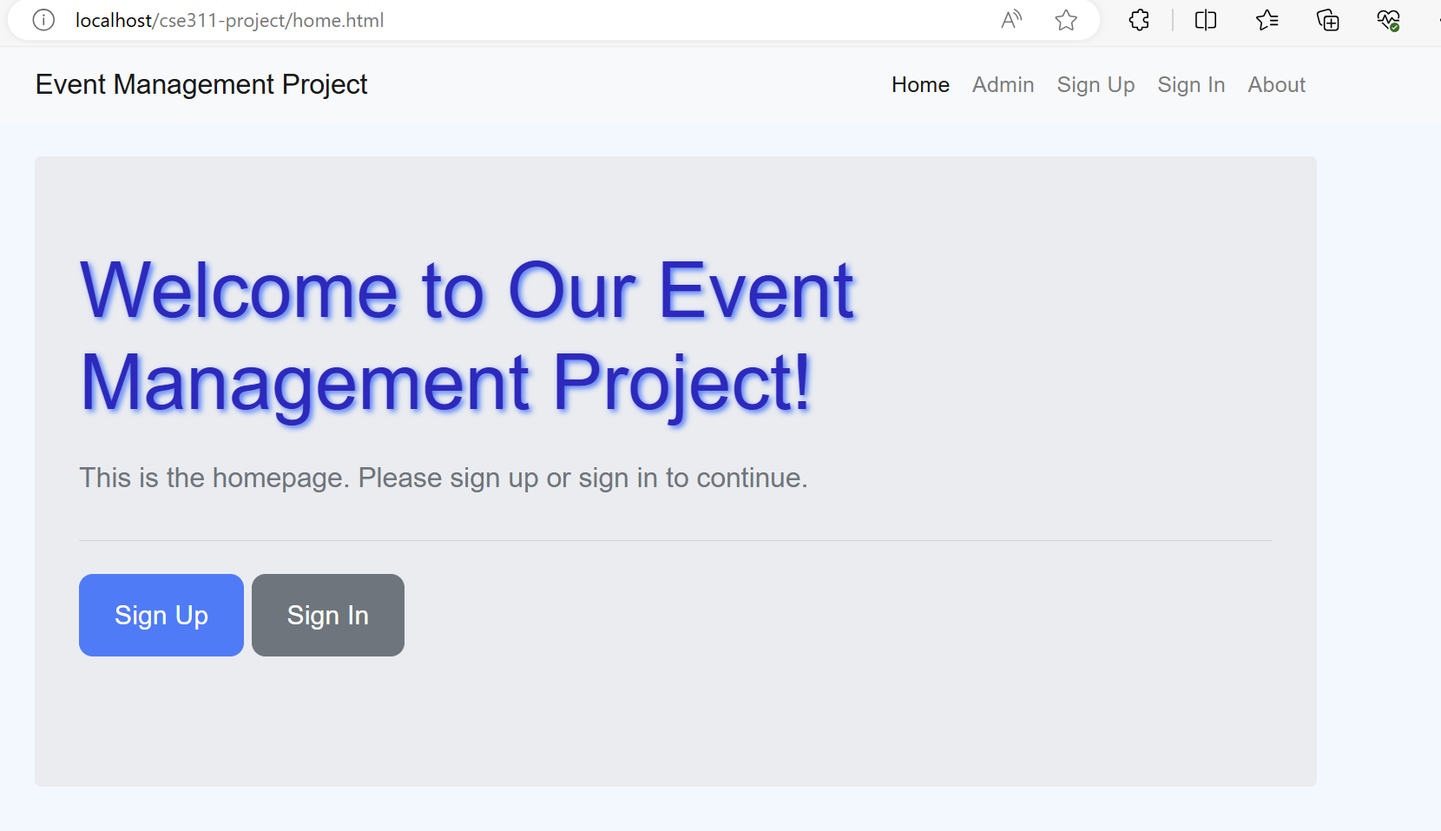
METHODOLOGY:
HOME-PAGE:
Navigation Bar: Specify the buttons included in the navigation bar. For example, mention buttons like Home, Admin, About, Signup, and Signin.
Admin: Admin can easily control it.
Signup and Signin: Clarify the process for users who are signing up for the first time and those who are signing in. Mention any specific features or functionalities related to these processes, such as form fields for registration, password requirements, or account verification methods.
About: Information about our support has been provided here.
User Experience: Highlight the user-friendly nature of the homepage. Describe how the layout and design elements facilitate easy navigation and interaction for users.

Slide 6
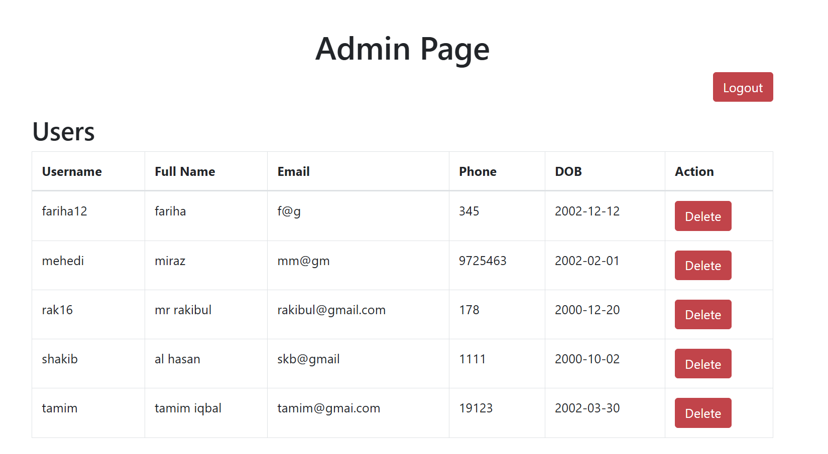
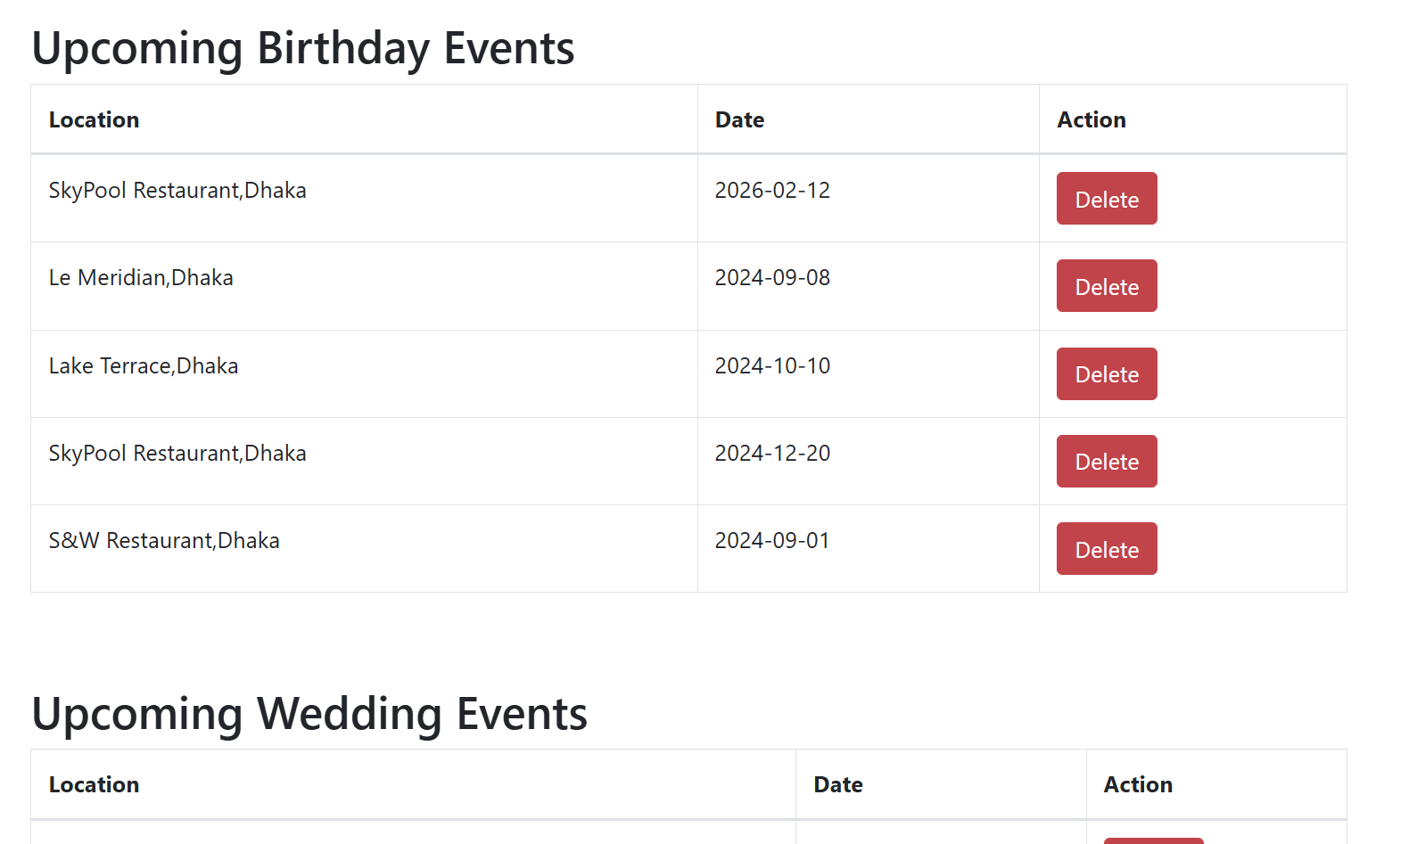
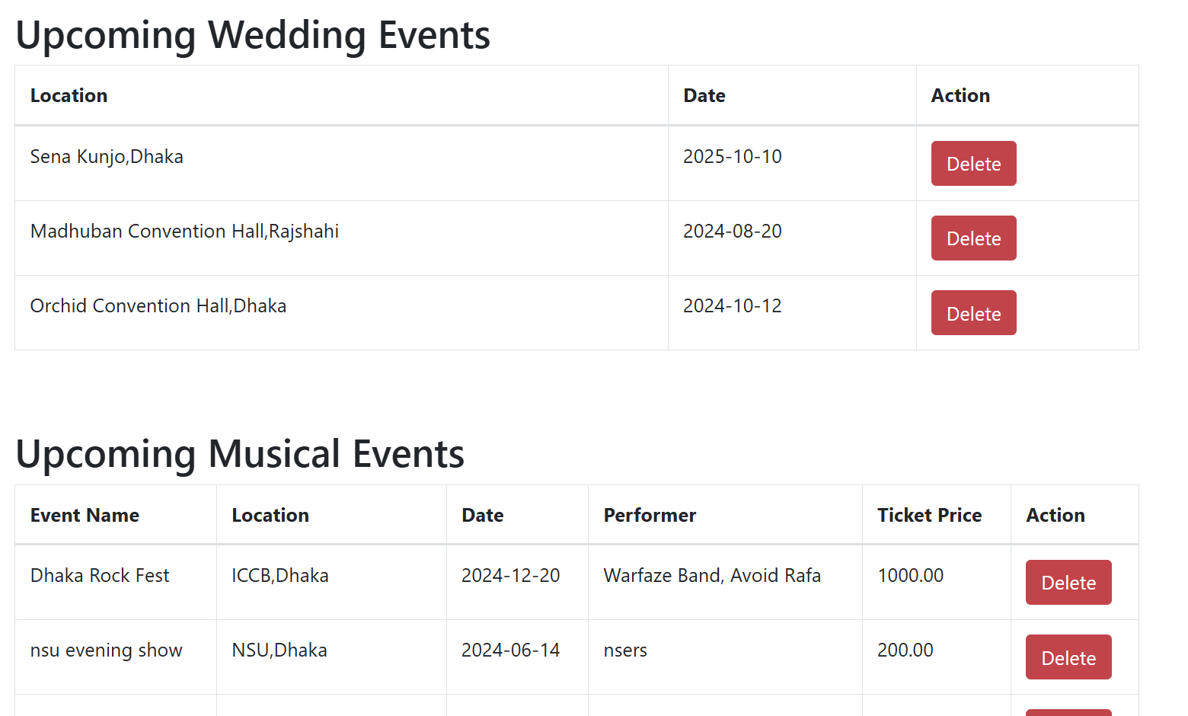
ADMIN Page:
This is the Admin Page. Admin can see all the users information along with upcoming events information. Admin can remove any users and events by clicking on Delete.

Slide 7
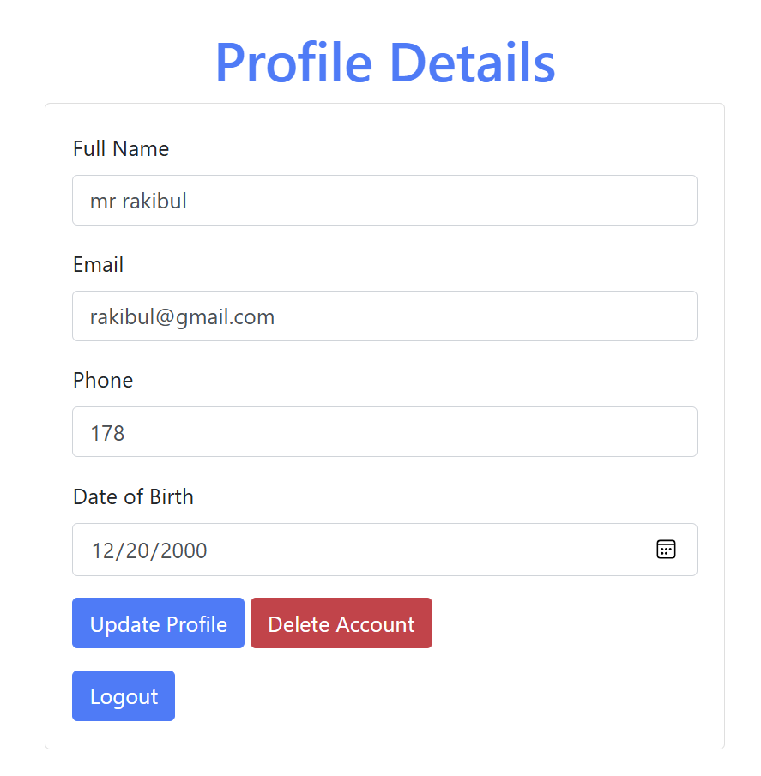
USERs' Profile:
In this page, User can easily upade their profile. If user wants to delete his account, he can also do it in thia page.After loggin out user will go back to the Homepage.

Slide 8
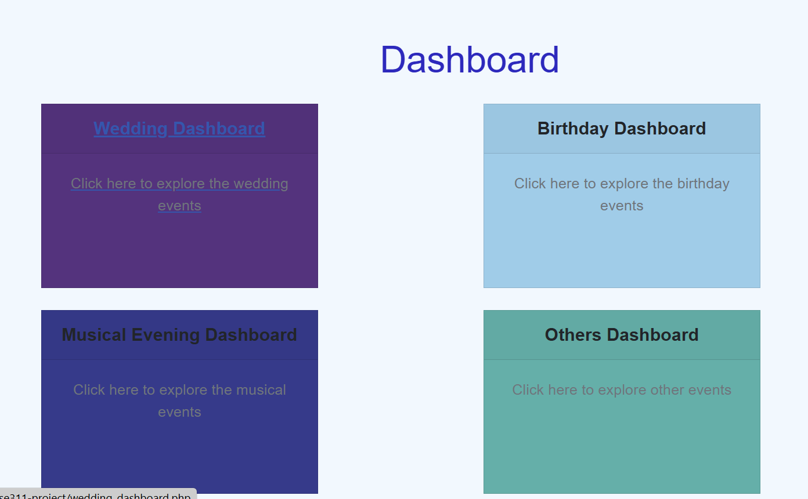
DASHBOARD:
In this page, users or guest can see the Dashboard.After clicking on desirable card, they can see their expected events details in the next page

Slide 9
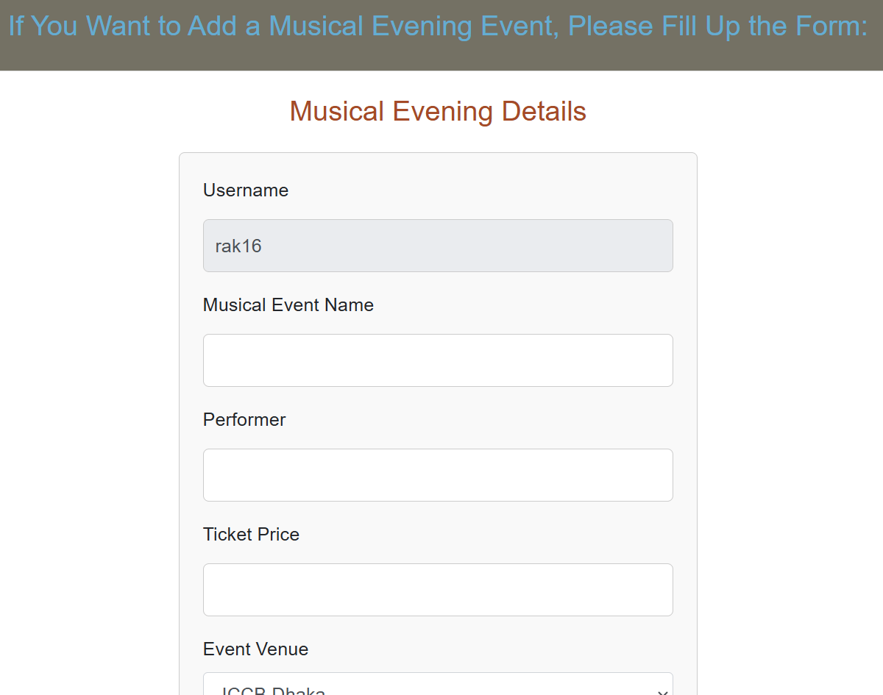
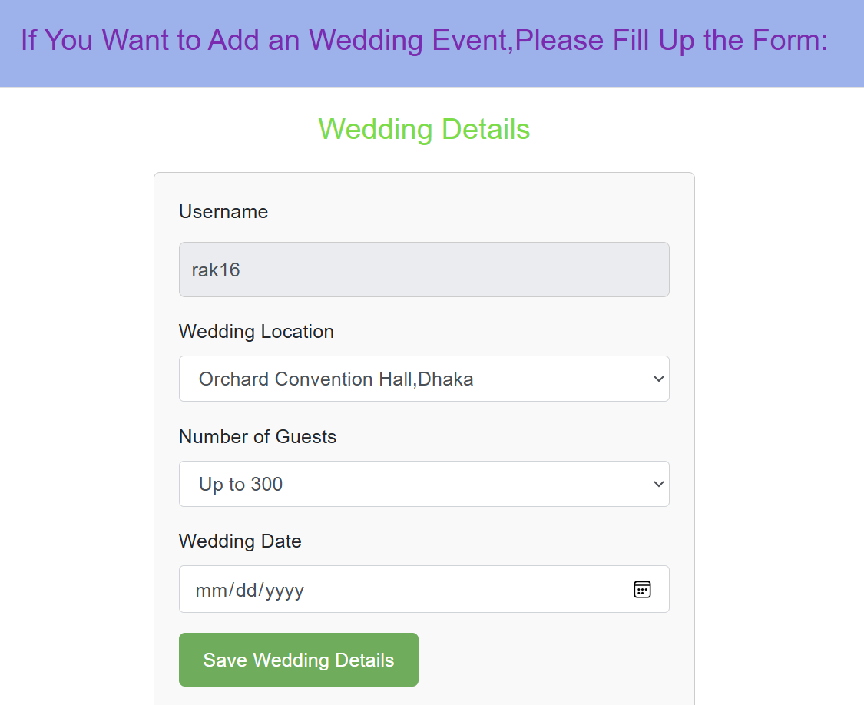
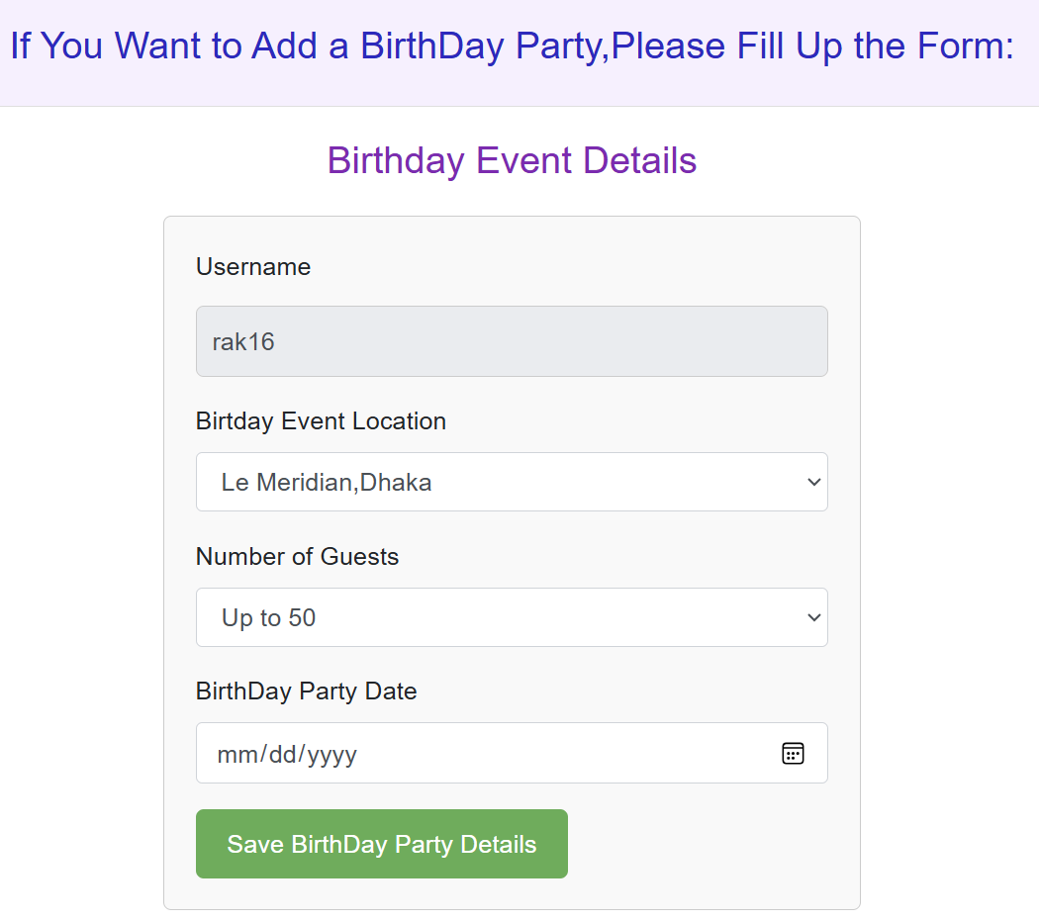
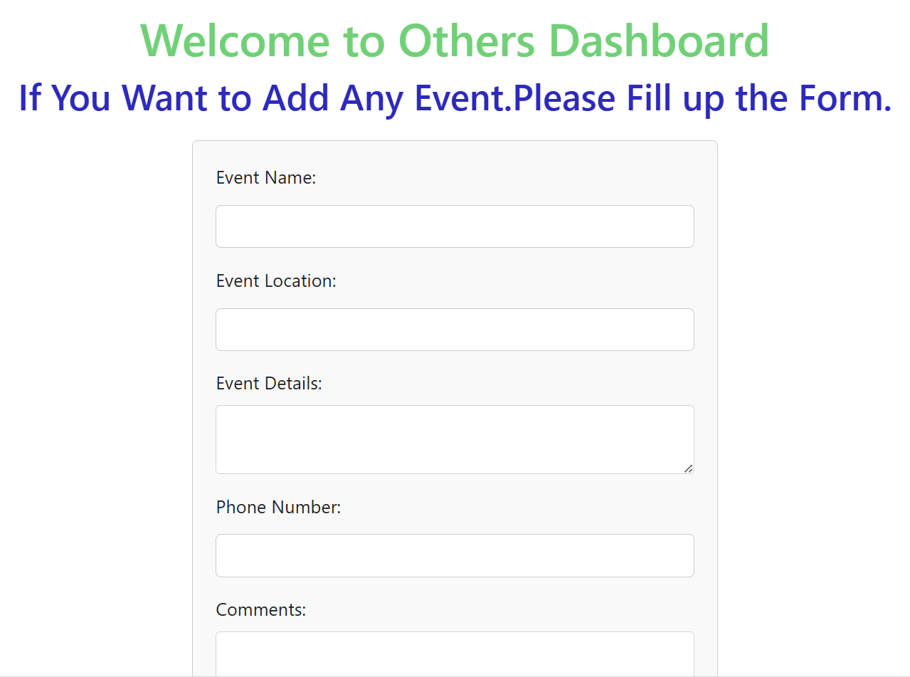
EVENTS:
If Users want to create any events, they can follow these forms. Events will be creater automatically in Events Dashboard.

Slide 10
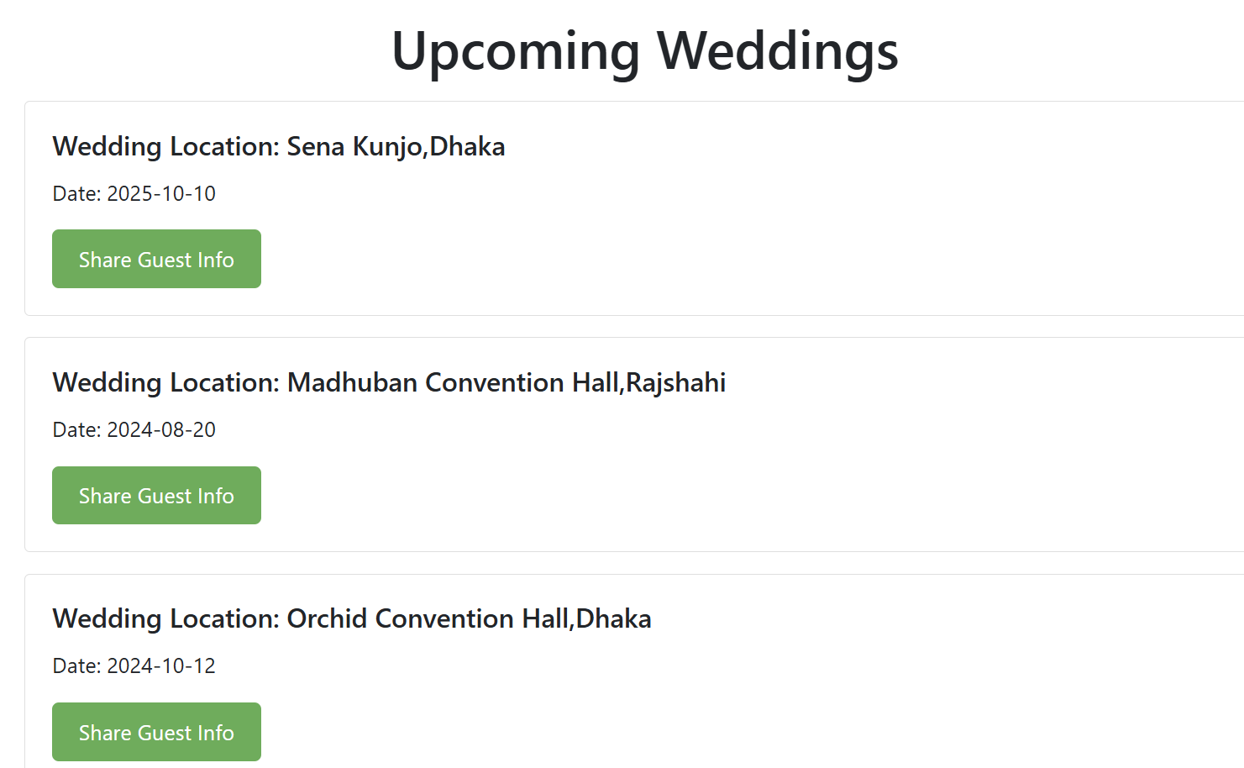
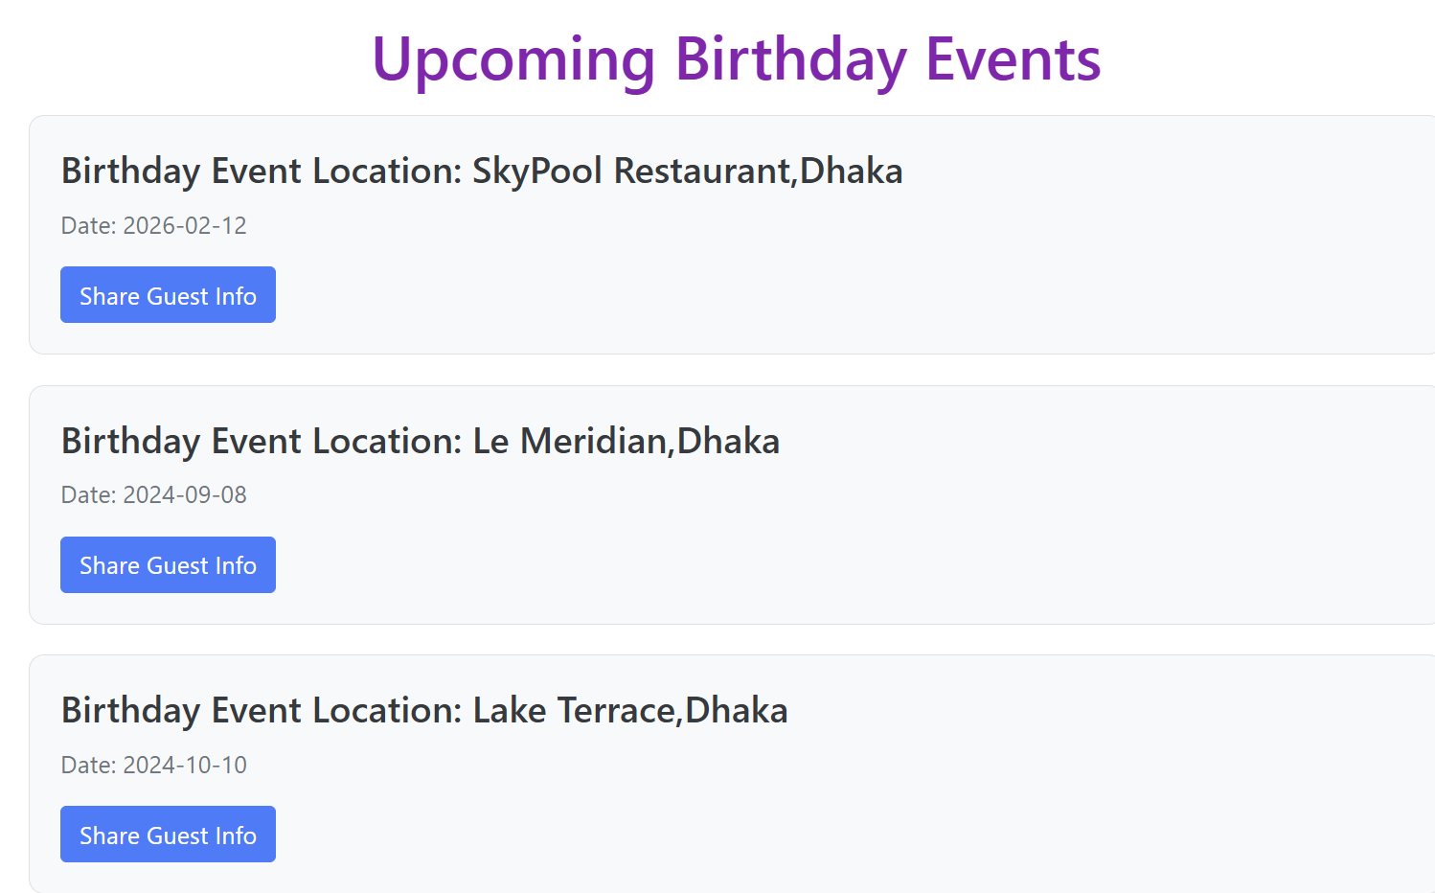
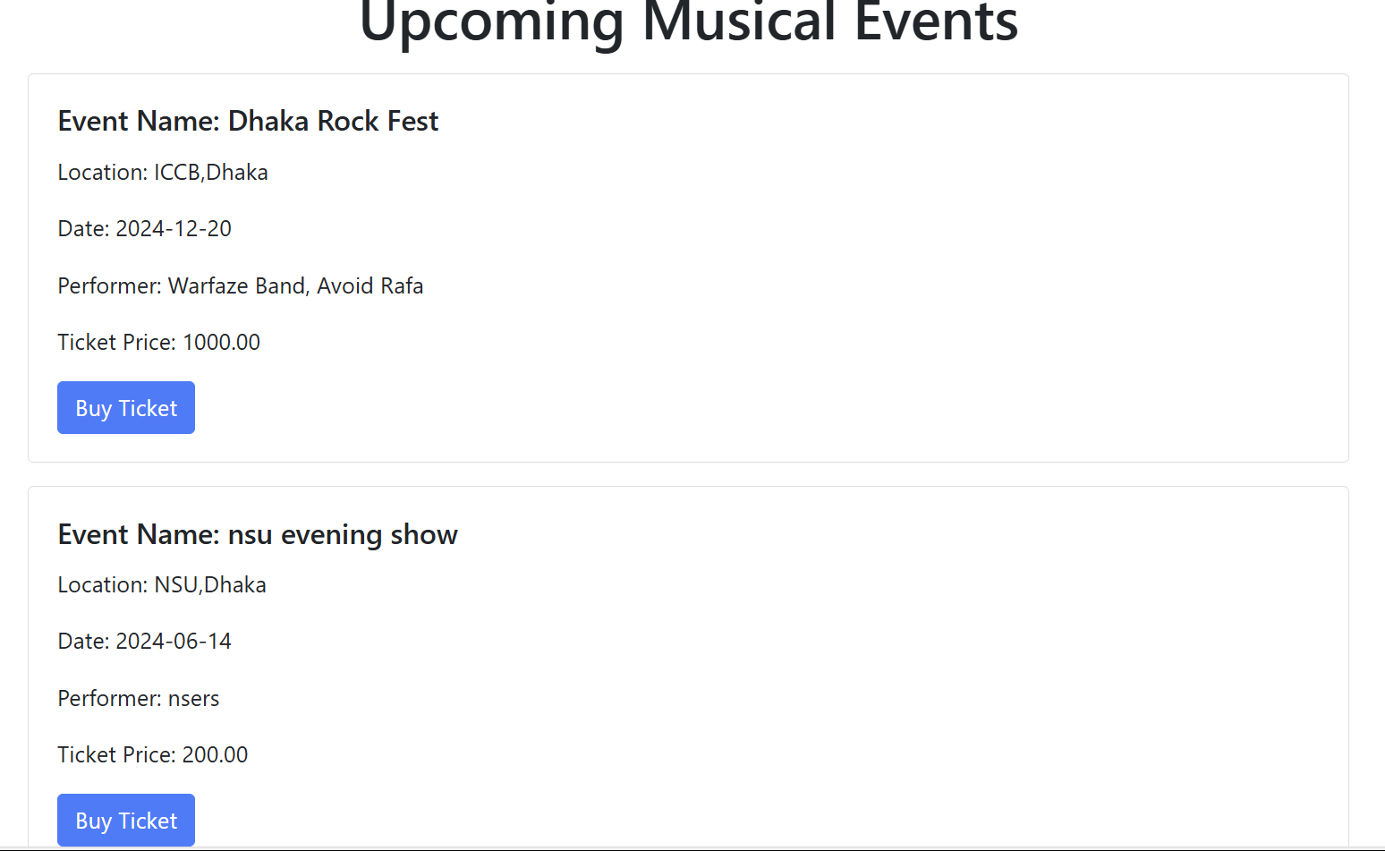
EVENTS DASHBOARD:
Every Event Dashboard will display the upcoming event or show. Guest and audience can follow this for their role.

Slide 11
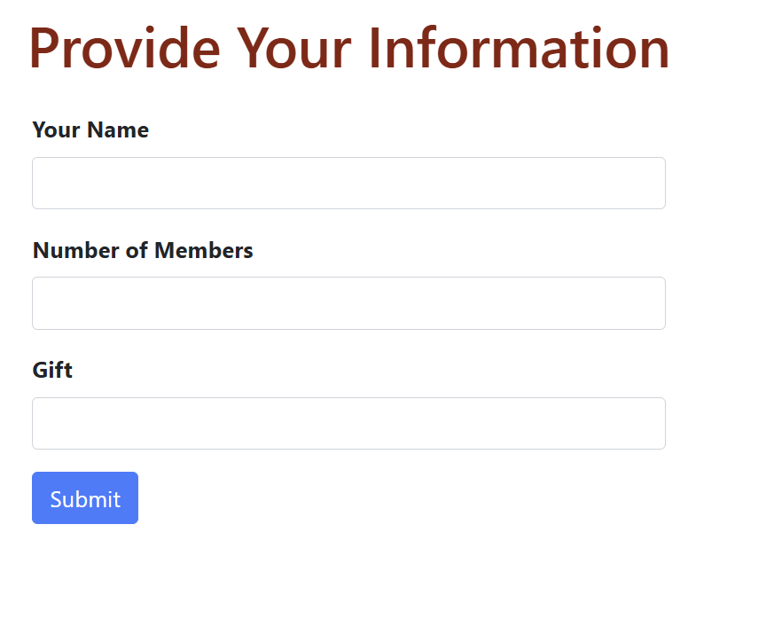
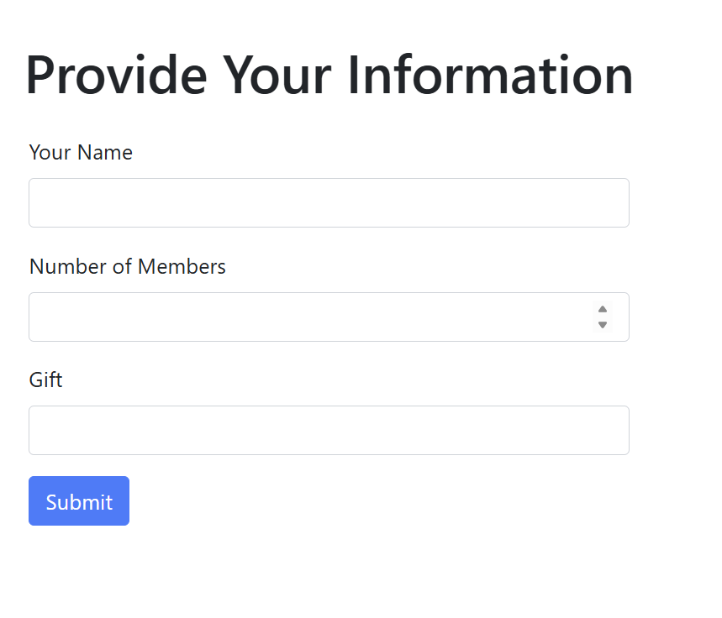
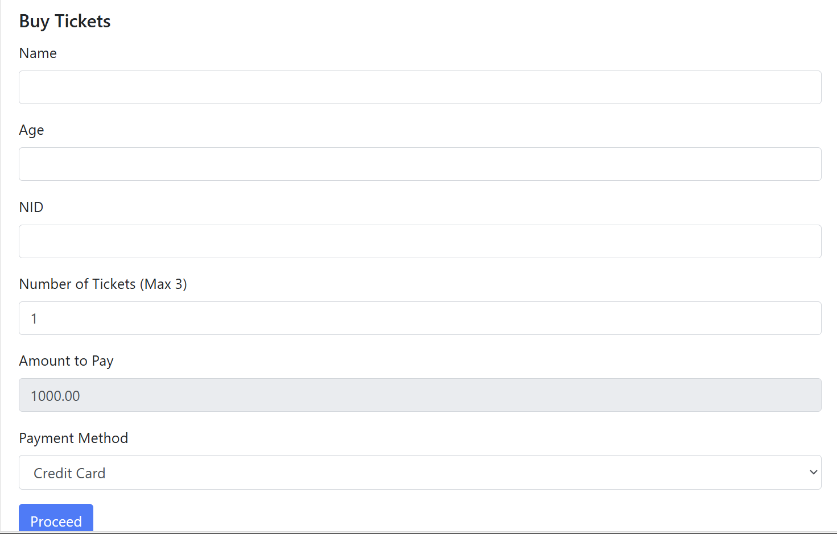
Guest and Audience:
Guest and Audience can easily complete their process following this page.

Slide 12
THANK YOU

